Slide 1
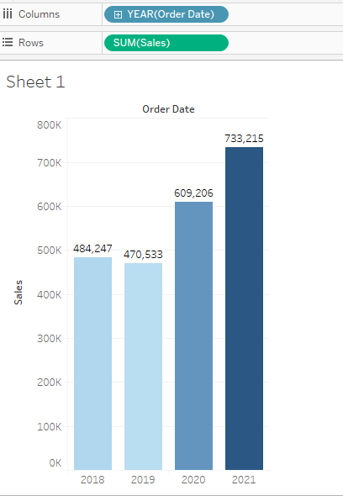
1. Find the sales for every year and find the highest sales and show the view in bar graph.
Year sales
2018 484247
2019 470533
2020 609206
2021 733215
Highest sales in the year 2021 with 733,215 sales

Slide 2
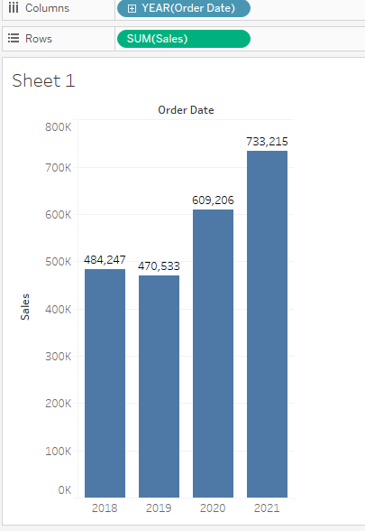
2. Add label to your view.

Slide 3
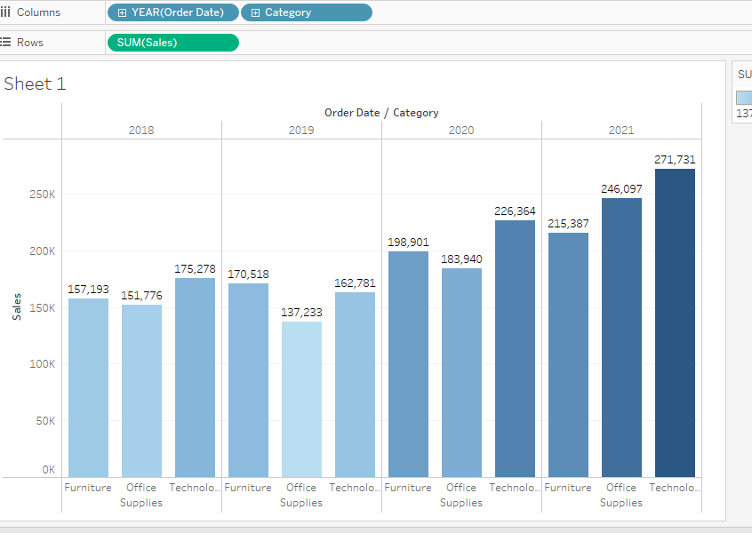
3. Find the category wise sales for every year.
4. Which category has highest sales in the year 2020 & 2021.
Year category sales
2020 Technology 226364 2021 Technology 271731

Slide 4
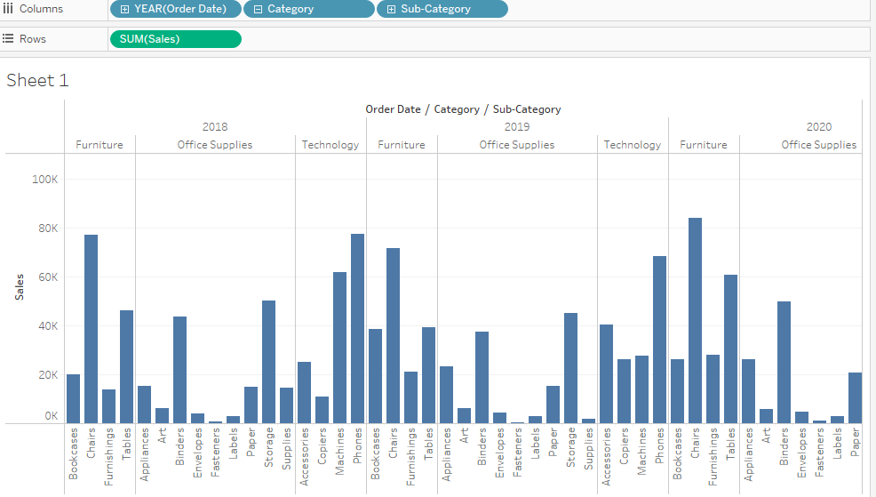
6. Display subcategory and find some insights from the view about max and min sales under every category.

Slide 5
Year -2018
Furniture's - Min- 13,826 – Furnishings Max- 77,242 – Chairs
Office Supplies - Min – 661 – fasteners Max- 50,329- storage
Technology – Min- 10,850 – copiers Max-77,391- Phones
Year -2019
Furniture's - Min- 21,090 – Furnishings Max- 71,735 – Chairs
Office Supplies - Min – 545 – fasteners Max- 45,048- storage
Technology – Min- 26,179 – copiers Max-68,314- Phones
Year -2020
Furniture's - Min- 26,275 – Bookcases Max- 83,919– Chairs
Office Supplies - Min – 960 – fasteners Max- 58,789- storage
Technology – Min- 41,896 – Accessories Max-78,962- Phones

Slide 6
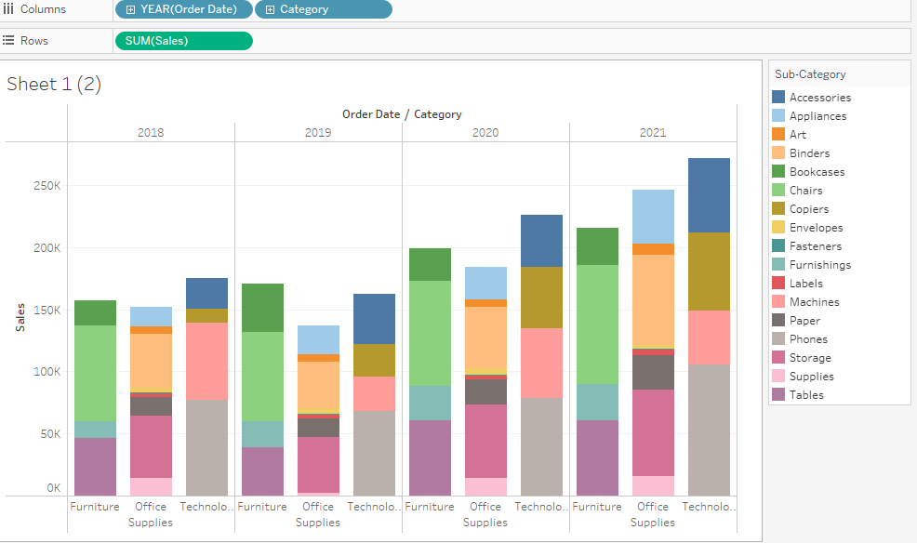
Year -2021
Furniture's - Min- 28,915 – Furnishings Max- 95,242– Chairs
Office Supplies - Min – 858 – fasteners Max- 72,788- Binders
Technology – Min- 43,575 – machines Max-105,341- Phones
8. In your bar graph, present subcategory under each bar of category using colour card

